Slide 1
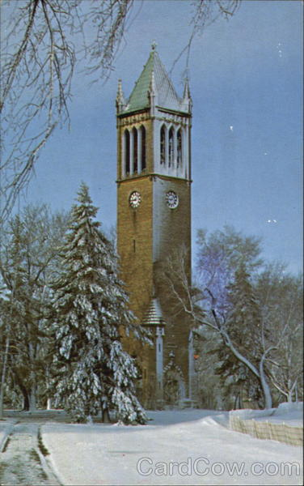
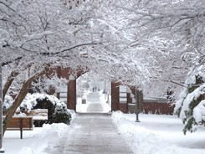
Winter in Ames
-fun outdoor activities-
IFC English Club

Slide 2
Average high temperature
January: 27 F (-3 C)
February: 34 F (1 C)
March: 47 F (8 C)
April: 62 F (16 C)
Ames is #6 on the list of US cities with the largest temperature difference during a year (Cities greater than 50,000)

Slide 3
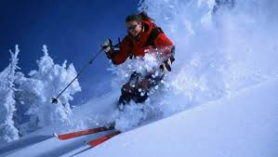
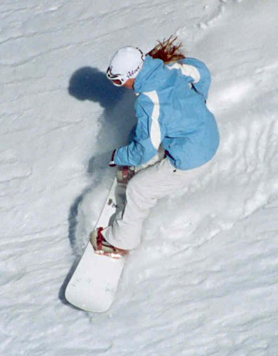
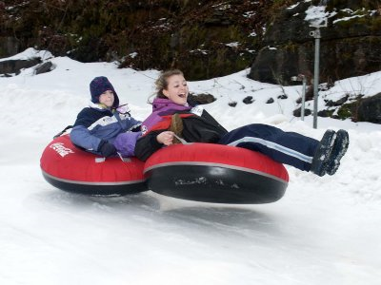
Outdoor activities: Skiing, Snowboarding and tubing

Slide 4
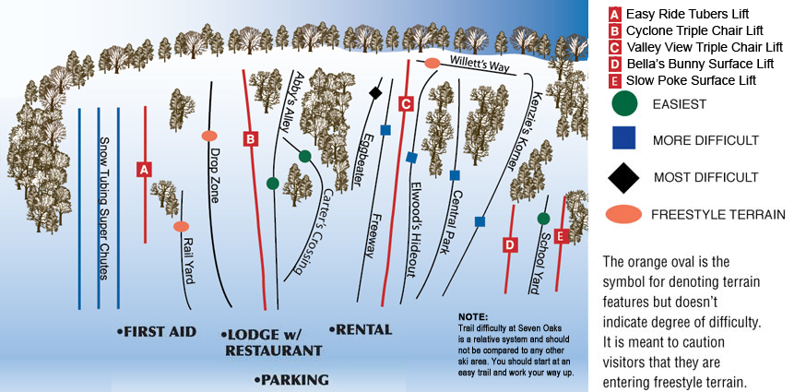
Seven Oaks Recreation
http://www.sevenoaksrec.com/ski.html
Located 17 miles west of Ames on Highway 30
Ski lift rental: $10-20
Ski rental: $16-20
Tubing: $14-18

Slide 5
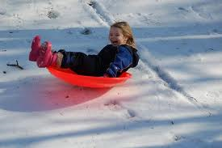
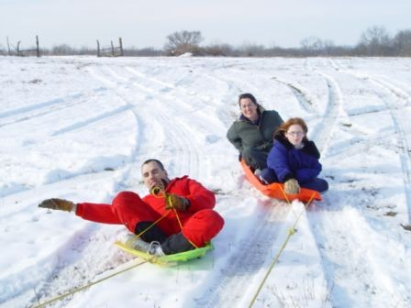
Sledding, it’s free!!
Gateway Hills, south of campus

Slide 6
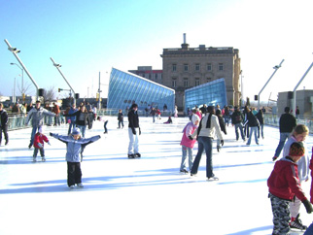
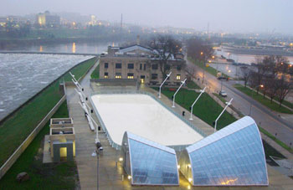
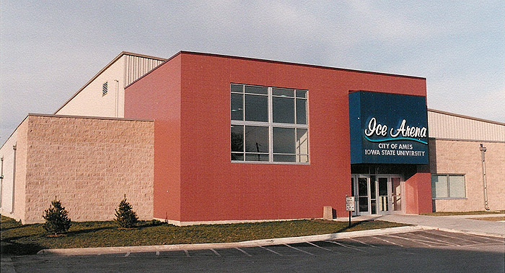
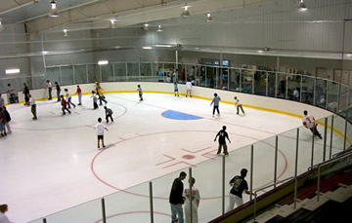
Ice Skating
Brenton Plaza, Des Moines: $5 plus $3 skate rental
Ames Ice Arena: $4.75 plus $2.75 skate rental

Slide 7
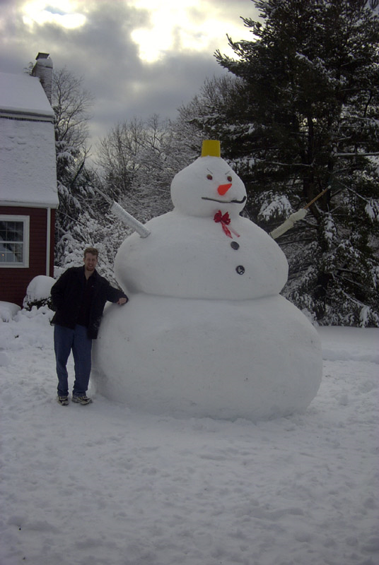
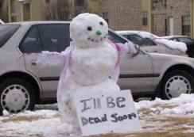
Build a snow man!

Slide 8
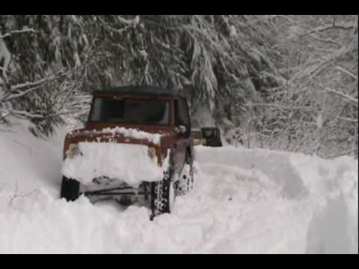
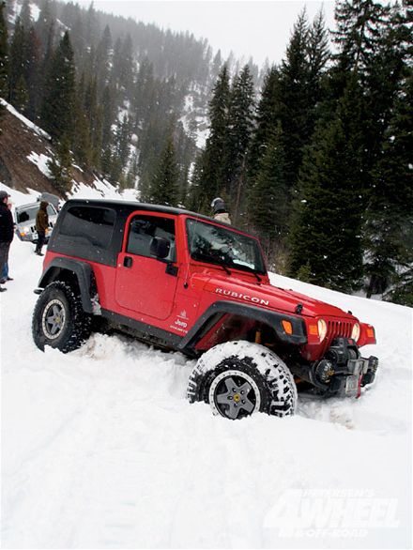
Winter Driving!!
http://www.youtube.com/watch?v=AS9tbEUSPOo&feature=related

